Slide 1
Introduction to XHTML

Slide 2
World Wide Web (WWW)
Extensible Hypertext Markup Language (XHTML)Paragraphs
Headers
Hyperlinks
Images, Sounds and Videos
Text styles and special characters
Ordered and unordered lists

Slide 3
World Wide Web (WWW)
Internet -> ~40 years
WWW -> ~20 years
Allows computer users to locate and view multimedia-based documents from the InternetText
Graphics
Animations
Audios
Videos

Slide 4
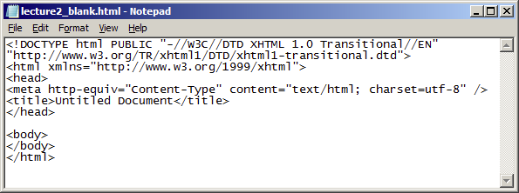
Extensible Hypertext Markup Language (XHTML)
a formatting language
a file with an extension .htm or .html
actually a plain text file

Slide 5
Extensible Hypertext Markup Language (XHTML)
Language
a system of signs used for communication –written and oral
XHTML is a language for communicating with Web browsers
Markup
the process of marking the content of the Webpage with directions about font type and size, indentation, spacing, etc
by means of “tags”
E.g.,<b>Hello, baby!</b>

Slide 6
Extensible Hypertext Markup Language (XHTML)
Text
the fundamental representation of letters or symbols without any decoration
no bold, underline, and italics information associated with the “text”

Slide 7
Extensible Hypertext Markup Language (XHTML)
Hyper
combined with the term “text” above
an concept developed from VannevarBush's 1932 visionary brainchild known as the “memex”
a document is no longer linear
sentence1 precedes sentence 2, which in turn precedes sentence 3, and so it goes on up the levels so that chapter 1 precedes chapter 2, which precedes chapter 3, and so on
a hypertext document contains links, and by clicking a link, a user is taken to a different page or different part of the same page

Slide 8
XHTML Example
<!DOCTYPE html PUBLIC "-//W3C//DTD XHTML 1.0 Transitional//EN" "http://www.w3.org/TR/xhtml1/DTD/xhtml1-transitional.dtd">
<html xmlns="http://www.w3.org/1999/xhtml">
<head>
<title>Richard B</title>
</head>
<body>
<h1 align="center">Home Page for Richard B</h1>
<hr />
<p><imgsrc="images/rb.jpg" width="30" height="90" alt="photo" /></p>
Business Analysis<br/>
<a href="http://www.abc-bank.com/">ABC Bank</a><br/>
1234 ABC Bank<br/>
ABC Street, Hong Kong<br/>
<i>Email:</i> <a href="mailto:richard@abc-bank.com">richard@abc-bank.com</a><br/>
<i>Phone:</i> (852) 4321-1234<brclear="all" />
<p> Hi I am Richard! </p>
</body>
</html>

Slide 9
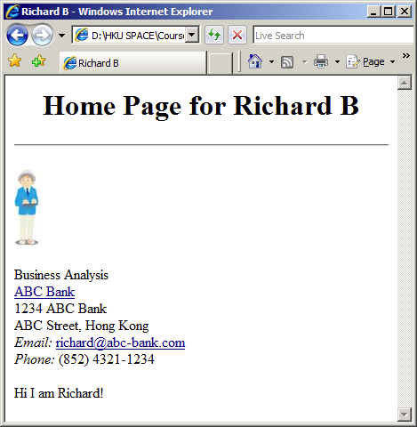
What you can see in Broswer

Slide 10
XHTML Document Template
<!DOCTYPE html PUBLIC "-//W3C//DTD XHTML 1.0 Transitional//EN" "http://www.w3.org/TR/xhtml1/DTD/xhtml1-transitional.dtd">
<html xmlns="http://www.w3.org/1999/xhtml">
<head>
<title>Untitled Document</title>
</head>
<body>
<!--Page content goes here -->
</body>
</html>

Slide 11
XHTML Document Template
DOCTYPEDeclarations
instruction to the web browser about what version of the markup language the page is written in
for validation only, nothing happen if we omit this declarations
XHTML 1.0 Transitional
contains all HTML elements and attributes, including presentational and deprecated elements (like font)
The markup must also be written as well-formed XML

Slide 12
First XHTML Example
<!DOCTYPE html PUBLIC "-//W3C//DTD XHTML 1.0 Transitional//EN" "http://www.w3.org/TR/xhtml1/DTD/xhtml1-transitional.dtd">
<html xmlns="http://www.w3.org/1999/xhtml">
<head>
<title>Internet and Web-based Systems Development</title>
</head>
<body>
<p>Welcome to IWSD!</p>
</body>
</html>

Slide 13
XHTML Main Elements
XHTML documents delimit an element with start and end tags
A start tag consists of the element name in angle brackets
An end tag consists of the element name preceded by a /in angle brackets
Note that XHTML is NOT case-sensitive

Slide 14
XHTML Main Elements
HTML
<HTML>… </HTML>
define the start and end of the html page
HEAD
TITLEelement required
In our example,
<head>
<title>Internet and Web-based Systems Development</title>
</head>

Slide 15
XHTML Main Elements
BODY
A XHTML document should have exactly ONE BODY element
Contains the page’s content that the browser displays when the user visits the Web page

Slide 16
XHTML Main Elements
P
<P>… </P>
Opening a new paragraph when editing XHTML does not make a new paragraph displayed in the browser
Leading whitespace ignored (use &nbsp;for whitespace)
Consecutive <P></P>’s do not yield multiple blank lines

Slide 17
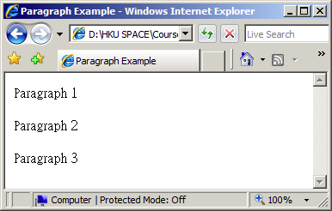
A Paragraph Example
<!DOCTYPE html PUBLIC "-//W3C//DTD XHTML 1.0 Transitional//EN" "http://www.w3.org/TR/xhtml1/DTD/xhtml1-transitional.dtd">
<html xmlns="http://www.w3.org/1999/xhtml">
<head>
<title>Paragraph Example</title>
</head>
<body>
<p> Paragraph 1 </p>
<p> Paragraph 2 </p>
<p> Paragraph 3 </p>
</body>
</html>

Slide 18
Headers
Some text in an XHTML document may be more important than others
For example,
the title in this slide is considered more important than the text here
Headerelements
H1, H2, H3, H4, H5and H6
specifying the relative importance of information
H1-> the most important
H6-> the least important
<H1>This is the header</H1>

Slide 19
A Header Example
<!DOCTYPE html PUBLIC "-//W3C//DTD XHTML 1.0 Transitional//EN" "http://www.w3.org/TR/xhtml1/DTD/xhtml1-transitional.dtd">
<html xmlns="http://www.w3.org/1999/xhtml">
<head>
<title>Header Examples</title>
</head>
<body>
<h1>Level-1 (H1)</h1>
<h2 align="center">Level-2 (H2)</h2>
<h3>Level-3 (H3)</h3>
<h4 align="right">Level-4 (H4)</h4>
<h5>Level-5 (H5)</h5>
<h6>Level-6 (H6)</h6>
</body>
</html>

Slide 20
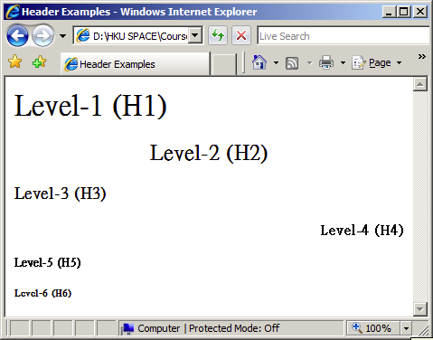
A Header Example

Slide 21
Attributes
Each element may contain extra information to describe its embedded content By means of attributes
E.g.,
<h2 align="center">Level-2 (H2)</h2>
align is the attribute
center is its value
Must be enclosed within quotation marks ""in XHTML
Aligning the text at the center of the browse
Other possible values
left(default) and right

Slide 22
Hyperlinks
<A HREF ...>...</A>
Links can contain images and other text-level elements links to Absolute URL
Use a complete URL beginning with http://
<a href="http://domain/path/lecture2.html">Lecture 2</a>
Link to Relative URL
Use a filename or relative path to filename
Interpreted with respect to location of current file
<a href="lecture2.html">Lecture 2</a>

Slide 23
A Hyperlink Example
<!DOCTYPE html PUBLIC "-//W3C//DTD XHTML 1.0 Transitional//EN" "http://www.w3.org/TR/xhtml1/DTD/xhtml1-transitional.dtd">
<html xmlns="http://www.w3.org/1999/xhtml">
<head>
<title>Hyperlinks Examples</title>
</head>
<body>
<p><a href="http://www.hotmail.com/">my Hotmail</a></p>
<p><a href="http://www.yahoo.com/">my news</a></p>
</body>
</html>

Slide 24
Nested Tags
<p>
<a href="http://hotmail.com/">my mail</a>
</p>
Nested tags
A pair of tags can contain an another pair of tags
The <a></a>tags are contained by the <p></p>tags
In our example,The hyperlink is in a paragraph

Slide 25
Images
<IMG src="value"/>
Display images of the two most popular formats
.gif (Graphics Interchange Format)
.jpeg/.jpg (Joint Photographic Experts Group)
Useful attributes
src
image file’s location specified in absolute URL or relative URL
width
image’s width in pixels
height
image’s height in pixels

Slide 26
An Image Example
<!DOCTYPE html PUBLIC "-//W3C//DTD XHTML 1.0 Transitional//EN" "http://www.w3.org/TR/xhtml1/DTD/xhtml1-transitional.dtd">
<html xmlns="http://www.w3.org/1999/xhtml">
<head>
<title>Image Examples</title>
</head>
<body>
<p><img src=“images/abc.jpg“/></p>
<p><img src=“images/def.jpg“ height=“70“ width=“490“/></p>
</body>
</html>

Slide 27
Sound & Video
OBJECT
src
sound or video file’s location specified in absolute URL or relative URL
paramtag
specifies parameters related to the document

Slide 28
Sound & Video Example
<!DOCTYPE html PUBLIC "-//W3C//DTD XHTML 1.0 Transitional//EN" "http://www.w3.org/TR/xhtml1/DTD/xhtml1-transitional.dtd">
<html xmlns="http://www.w3.org/1999/xhtml">
<head>
<title>Image Examples</title>
</head>
<body>
<p> Sound <br/>
<object type="audio/x-midi">
<paramname="src" value="multimedia/somewhere.mid" />
<paramname="autoplay" value="false" />
<paramname="autoStart" value="0" />
</object>
<br/>
</p>
<p> Movie Clip <br/>
<object type="video/mpeg">
<paramname="src" value="multimedia/game.mpg" />
<paramname="autoplay" value="false" />
<paramname="autoStart" value="0" />
</object>
</p>
</body>
</html>

Slide 29
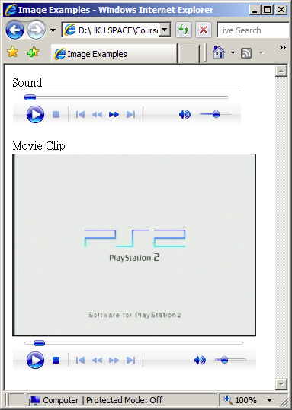
Sound & Video Example

Slide 30
Character Styles
Physical character tags
controls how to format the text
E.g.,bold, italics, subscript, superscript
Logical character tags
describes how the text is being used
E.g.,citation, emphasis, definition
For example, though <i></i>and <em></em> mayhave the same outcome in browser
Use <i></i>for the sake of using italics
Use <em></em> to convey some special meaning

Slide 31
Physical Character Styles
<!DOCTYPE html PUBLIC "-//W3C//DTD XHTML 1.0 Transitional//EN" "http://www.w3.org/TR/xhtml1/DTD/xhtml1-transitional.dtd">
<html xmlns="http://www.w3.org/1999/xhtml">
<head>
<title>Physical Character Styles</title>
</head>
<body>
<h1>Physical Character Styles</h1>
<b>Bold</b><br/>
<i>Italic</i><br/>
<tt>Teletype (Monospaced)</tt><br/>
<U>Underlined</U><br/>
Subscripts: f<sub>0</sub> + f<sub>1</sub><br/>
Superscripts: x<sup>2</sup> + y<sup>2</sup><br/>
<small>Smaller</small><br/>
<big>Bigger</big><br/>
<STRIKE>Strike Through</STRIKE><br/>
<b><i>Bold Italic</i></b><br/>
<big><tt>Big Monospaced</tt></big><br/>
<small><i>Small Italic</i></small><br/>
<font color="GRAY">Gray</font><br/>
<del>Delete</del><br/>
<ins>Insert</ins><br/>
</body>
</html>

Slide 32
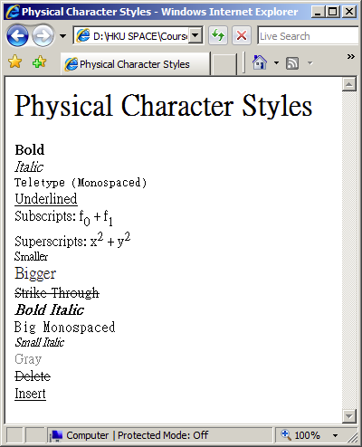
Physical Character Styles

Slide 33
Logical Character Styles
<!DOCTYPE html PUBLIC "-//W3C//DTD XHTML 1.0 Transitional//EN" "http://www.w3.org/TR/xhtml1/DTD/xhtml1-transitional.dtd">
<html xmlns="http://www.w3.org/1999/xhtml">
<head>
<title>Image Examples</title>
</head>
<body>
<h1>Logical Character Styles</h1>
<em>Emphasized</em><br/>
<strong>Strongly Emphasized</strong><br/>
<code>Code</code><br/>
<samp>Sample Output</samp><br/>
<kbd>Keyboard Text</kbd><br/>
<dfn>Definition</dfn><br/>
<var>Variable</var><br/>
<cite>Citation</cite><br/>
<em><code>Emphasized Code</code></em><br/>
<cite>Gray Citation</cite><br/>
<acronym title="Java Development Kit">JDK Acronym</acronym>
</body>
</html>

Slide 34
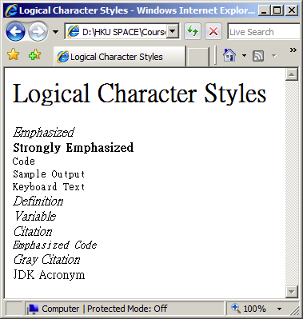
Physical Character Styles

Slide 35
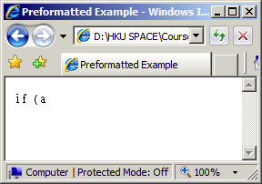
Preformatted paragraph
<PRE> ...</PRE>
Display the text in exact format typed in XHTML
For example,
<PRE>
if (a<b) {
// do sth
} else {
// do sth
}
</PRE>

Slide 36
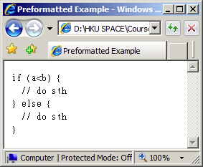
Special Characters
Character to be displayed | XHTML code
< | &lt;
> | &gt;
& | &amp;
" | &quot;
Non-breaking space | &nbsp;
<PRE>
if (a&lt;b) {
// do sth
} else {
// do sth
}
</PRE>

Slide 37
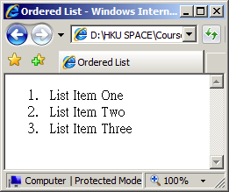
Ordered List
<OL>
<LI>…</LI>
<LI>…</LI>
</OL>
Attributes
type
The starting number or alphabet of the list
"1" (default),"A","a","I"or"i"
A sample list
<OL>
<LI>List Item One</LI>
<LI>List Item Two</LI>
<LI>List Item Three</LI>
</OL>

Slide 38
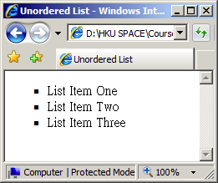
Unordered List
<UL>
<LI>…</LI>
<LI>…</LI>
</UL>
Attributes
Type
DISC (default)
CIRCLE
SQUARE
A sample list
<UL>
<LI>List Item One</LI>
<LI>List Item Two</LI>
<LI>List Item Three</LI>
</UL>

Slide 39
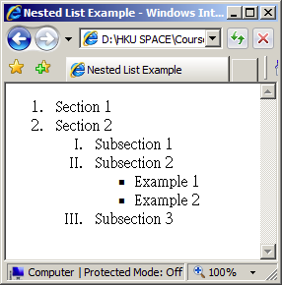
Nested Lists
Ordered and unordered lists can contain another list in a nested manner

Slide 40
Nested Lists
<!DOCTYPE html PUBLIC "-//W3C//DTD XHTML 1.0 Transitional//EN" "http://www.w3.org/TR/xhtml1/DTD/xhtml1-transitional.dtd">
<html xmlns="http://www.w3.org/1999/xhtml">
<head>
<title>Nested List Example</title>
</head>
<body>
<ol>
<li>Section 1</li>
<li>Section 2
<ol type="I">
<li>Subsection 1</li>
<li>Subsection 2
<ul>
<li>Example 1</li>
<li>Example 2</li>
</ul>
</li>
<li>Subsection 3</li>
</ol>
</li>
</ol>
</body>
</html>

