Slide 1
Introduction
In this module we are going to be looking at the development of dynamic websites.
Over the past ten or so years, websites have become more and more interactive.
The web has changed a lot in that time.
When the Internet was first becoming a mainstream resource, static web pages were the norm.
Perhaps with some animated graphics if you were feeling artistic.

Slide 2
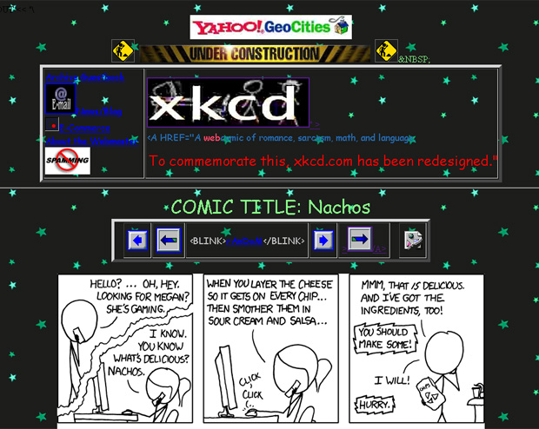
The Old Internet - 1

Slide 3
The Old Internet - 2
Static web pages needed to be refreshed by the server every time data changed.
Almost everything was done server side.
This made working with web pages very slow.
Every action would require a sending of user data, a forming of a page, and the downloading and parsing of that page.
As time went by, more and more of the work of a web page was shifted to the client.

Slide 4
The Modern Internet
On the modern internet, web pages are often fully functioning applications.
Facebook
Google apps
Much of the processing is done in real time on the client side.
The web page contains the instructions for the browser.
The browser does the work of formatting data
This has allowed for much more interactivity.

Slide 5
Web Applications - 1
You hear a lot about web applications these days.
Usually with the term ‘cloud computing’
The distinction between ‘web’ applications and ‘desktop’ applications is becoming less meaningful on a yearly basis.
Most desktop applications incorporate internet functionality.
Most web applications now imitate the look and feel of desktop applications.

Slide 6
Web Applications - 2
There is now even an operating system fully designed to work on the web.
Google’s Chrome OS
Desktop applications still have numerous benefits:
Bandwidth is still a major bottleneck in highly interactive performance
Privacy and security is easier when you have control over the data
It’s possible to optimise for the desktop context.

Slide 7
Web Applications - 3
It has never been more important to be able to develop dynamic websites.
People expect a lot of websites
Web applications offer many advantages to both developers and users:
Easily maintained
Easily deployed
Always available
Provided you have an internet connection

Slide 8
The Parts of a Web Application - 1
In the most general sense, we break a web application into three ‘layers’, each responsible for a different part of the system.
The Presentation layer, which handles the user frontend
The Application layer, which handles the ‘business logic’
The Data layer, which handles storage and retrieval of data.
This is usually called an N-Tier architecture, where N is the number of tiers.

Slide 9
The Parts of a Web Application - 2
Different tools are used to handle the complexities of each of the tiers.
We separate them out to ensure maximum flexibility when we build applications.
At the user level, languages such as Javascript and formats such as CSS are commonplace.
For the application levels, PHP or other server-side languages are used.
For the data level, MySQL and Oracle are common.

Slide 10
Presentation
Much of what is done at the presentation level is to do with the user experience.
Formatting the website properly
Handling simple data validation
Animation and interface flourishes
It is more seamless for this to be handled in the user’s client browser.
When updated data is required (to update the user interface), that request is sent to the application layer.

Slide 11
Application
The application layer handles all the functionality.
The things that you would generally think of as the ‘programming’
Often referred to as the ‘business logic’
Most often handled on the server via a language such as PHP
Also serves as the mediator between the presentation and the data.
All interaction between those two should be done via this layer.

Slide 12
Data
The data layer is responsible for optimised data access
This can be done in the application layer, but there are benefits to using a dedicated layer.
This is most often handled using a database management system such as MySQL.
The data layer can handle caching of data, and persistent storage.
It can also handle load-balancing between servers.

Slide 13
The Tools of this Module
In this module, we are going to be developing N-Tier dynamic websites using the following tools:
XHTML, to handle the presentation layer
PHP to handle the application layer
MySQL to handle the data layer
This is a very flexible set of tools.
This combination is used for all sorts of real world web applications.

Slide 14
PHP
PHP (originally this stood for personal home page) is a server side scripting language.
We embed PHP code into our HTML pages.
The server processes this PHP code before it gets sent to the browser.
PHP incorporates a number of flexible tools that make it useful for implementing an application layer.
Including native support for MySQL.

Slide 15
MySQL
MySQL is a database management engine.
It is very popular because it is open source and very reliable.
With MySQL, we make use of relational database structures to store our data.
We access it in our web pages via PHP
MySQL lets us concentrate on the business logic and presentation without worrying about data structures.

Slide 16
The Client and the Server
This type of development model is often referred to as a client-server application
This describes a distributed application – one where some of the work is handled locally (in your browser) and the rest is handled externally (on a server).
Strictly speaking, both of these can be located on the same computer.
And this is common for small-scale development.

Slide 17
Client-Server Architectures - 1
There are advantages to this kind of approach:
Highly maintainable
Centralised storage of data can (given good intentions) increase security of critical data
Data updates can be applied quickly and shared amongst all users of the data
Large-scale optimisation can be performed.
Load balancing and using clusters are common examples.
Opportunities for interleaving data in ways that are not possible otherwise.

Slide 18
Client-Server Architectures - 2
There are disadvantages too:
If the server(s) go down, everyone loses access to the application.
There are bandwidth considerations when working with large numbers of users.

Slide 19
Evaluation - 1
Choosing which architecture and tools to use is an important consideration.
In order to be able to assess if we made an appropriate choice, we have to be able to evaluate our success.
This is made more complicated for web-based development.
We must be sure our tools are properly formed.
We must be sure our tools work across multiple platforms.

Slide 20
Evaluation - 2
Evaluation of our tools can be partially automated.
There are many tools that will check to see if our web pages are well formed and conform to standards.
We also have to consider the potential userbase of our web applications.
This involves being mindful of issues such as accessibility.
We will discuss this in more depth in a later lecture.

Slide 21
Our Task
Our task then, as the developers of dynamic websites has several substantial sub-tasks associated:
Analyse and understand a problem
Assess and understand our user-base
Design a solution
Decide on the appropriate tools with our design in mind
Develop the client-side applications
Develop the server-side applications
Evaluate our success

Slide 22
Reinventing the Wheel
Luckily, all this talk of platform independence reveals an important benefit of dynamic web pages.
There’s a lot of ‘free’ functionality already out there.
We can use existing services like Google, Amazon and Facebook by making use of these exact same protocols and languages.
We don’t need to reinvent the wheel!
We can get a lot of our work done by using existing tools available as part of standard Application Programming Interfaces (APIs).

Slide 23
Terminology - 1
N-Tier Architecture
A software application that is explicitly designed in separate component layers.
Client-Server Architecture
A software application where a client communicates with a central server.

Slide 24
Terminology - 2
PHP
A server side scripting language suitable for providing the business logic of a software application.
MySQL
A database management engine

